Slide 1

Welcome to the Online Trade Session
Thank you for joining the online Trade Session. In this video we will talk about the many benefits of the Federal Trade Program.

Slide 2
Qualifying Requirements - TAA
To qualify for Job Search Allowances, Relocation Allowances, and Training, you must:
  Be a member of a group of workers covered under a certified petition;
  Be separated on or after the impact (beginning) date and before the termination or expiration (ending) date of the certified petition;
  Be separated due to lack of work; and
  Be laid off for 7 or more consecutive days, or put on a reduced work schedule.

Slide 3
Appeals
You have the right to appeal all written decisions, or determinations, issued to you, just as with the determinations you received for regular Unemployment Insurance. Each determination will have specific appeal instructions included on the determination form.

Slide 4
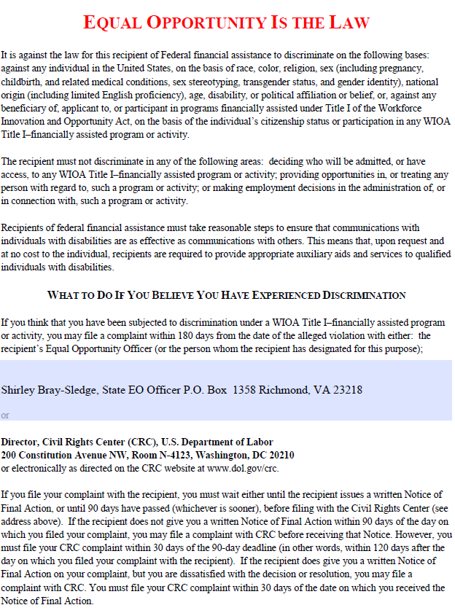
EEO Statement
Shirley Bray-Sledge, State EO Officer, P.O. Box 26441, Richmond, VA 23261
or

Slide 5


Goal of TAA
To provide assistance to workers affected by foreign imports to return to suitable employment as quickly as possible.

Slide 6

TAA Benefits & Reemployment Services
Income Support (TRA)-conditions apply
Training
Job Search Allowance
Relocation Allowance
Reemployment Trade Adjustment Assistance (RTAA)
Health Coverage Tax Credit (HCTC)

Slide 7
What is Waiver from Training?
The enrollment-in-training deadline may be waived only if enrollment in training is not feasible or
appropriate for one or more of the following reasons:
Health -You are unable to participate in, or complete training due to your health. (This does not exempt you from requirements relating to the availability for work, active search for work, or refusal to accept work under federal or state unemployment compensation laws.)
Enrollment Unavailable -The first available enrollment date for approved training is within 60 days after the issued date of the waiver, or, if later, there are extenuating circumstances for the delay in enrollment.
Training Unavailable -Training is not reasonably available, suitable training at a reasonable cost is not available, or training funds are not available.

Slide 8

TAA Training

Slide 9
What type of trainings are available?
On-the-Job Training –
Customized Training
Apprenticeship Programs
Distance Learning (has requirements)
Classroom/Occupational Training
Remedial Training to obtain your GED or Developmental courses
English as a Second Language-ESL

Slide 10
TAA Training
BEFORE training is approved a comprehensive skills assessment must be conducted by our Workforce Innovation & Opportunity Act (WIOA) partner.
If the assessment determines:
That you have skills needed for the current labor market; then it will be expected that you seek employment with assistance from Trade Act Reps and Re-Employment Specialist.

Slide 11
TAA Training
If the assessment determines:
B) That you lack the skills needed for the current labor market; occupational skills training is needed to achieve the reemployment goal, then VEC Trade Act staff will explore training with you.

Slide 12

Job Search
Complete Registration on Virginia Workforce Connection at www.vawc.virginia.gov to include resume.
Work with Workforce Service Representatives at local VEC for referrals to suitable employment
Keep detail records of job search to include:
  Date; Company Name; Address;
  Phone; Contact Name; Email Address; Website Address; Job Title; How you applied; Confirmation Number; and results of contact

Slide 13
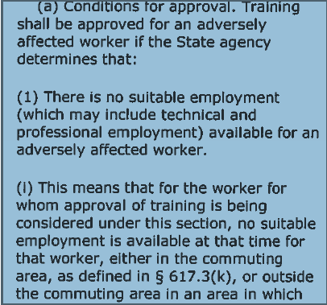

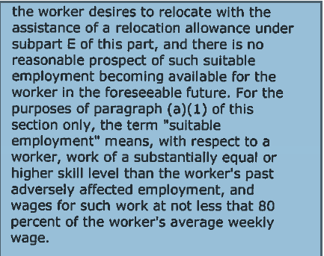
Approval of Training §617.22

Slide 14

TAA Training Requirements must meet
Six (6) Criteria
No suitable employment within the current labor market is available to you.
There is reasonable expectation of employment following completion of the training.
You have the physical, mental, and financial capabilities to complete the training

Slide 15
Six (6) Criteria Continued
The training is reasonably available from either governmental or private sources
You have the background, education, skills or experience to succeed in the training
The training is suitable for the worker and available at reasonable cost.

Slide 16
Job Search Allowance
Job Search Allowance – May cover the cost of necessary job search expenses.
Maximum amount paid is $1250 per certification.
Deadline to apply - 365 days after certification or your last total separation, or 182 days after training is completed, unless the worker received a training waiver.
A determination must be made showing that it is necessary for you to obtain work outside your commuting area.
Prior Approval Is Needed

Slide 17
Relocation Allowance
After an assessment, if it is determined that suitable work is not available in your current area of residence, and
You find long term work or a bona fide offer of work within the United States (must meet the suitable employment definition),
Reasonable and necessary relocation expenses may be covered, and A Lump Sum equal to 3 times your former average weekly wage up to a maximum of $1,250.
Deadline to apply - 425 days after certification or your last total separation, or 182 days after training concluded, unless the worker received a training waiver.
Prior Approval Is Needed

Slide 18
Reemployment Trade Adjustment Assistance (RTAA)
For Workers
50 and older

Slide 19

What is RTAA?
RTAA is a program that provides eligible individuals who obtain new employment with a 50% wage subsidy to help bridge the salary gap between their old and new employment .

Slide 20
Who is Eligible for RTAA:
To be Eligible for RTAA a worker must:
Receive entitlement to TAA
Be at least 50 years of age.
Be projected to earn less than $50,000.00/year in new employment
May not be employed by the TAA-certified employer

Slide 21
RTAA with Training
a. If not enrolled in Trade Act approved training, must be reemployed full time as defined by the state of Virginia (32 or more hours each week)
or
If enrolled in TAA approved training, must be employed at least 20 hours per week.
The 20/32 hours can consist of more than one employer.

Slide 22

RTAA Wage Subsidy
If no TRA benefits have been received by the worker:
  RTAA benefits may be paid for a period of up to 104 weeks or $10,000.00, whichever occurs first.
If TRA benefits have been received by the worker prior to the RTAA claim:
  Any amount of TRA is deducted dollar for dollar from the maximum $10,000.00 balance.

Slide 23
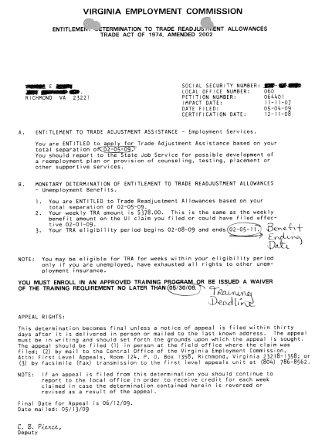
Entitlement Letter
This letter will confirm your entitlement to Trade Act benefits.
KEEP THIS LETTER,
IT’S VERY IMPORTANT!!
Address

Slide 24
Health Coverage Tax Credit (HCTC)
72.5 percent health coverage tax credit for eligible TRA and RTAA recipients in the TAA Program.
Program operated by IRS and more information can be found at http://www.irs.gov/HCTC

Slide 25
Your Responsibilities
Read the information and materials carefully.
Use the services offered by your Job Center and other community resources.
Keep a notebook of your efforts to find work.
Get your assessment completed by WIOA.
Apply for benefits within the specified time frames.
Email your assigned TAA mailbox.

Slide 26

What you have received in the mail.
Official Notification to review this Power Point Presentation and instructions on how to join a conference call on the designated date and time.
A list of forms needed and instructions on how to print the forms needed.
Due to COVA 19 Pandemic your local One Stop Centers may be closed. You will need to print the documents needed through family members, friends, library etc.

Slide 27
What you’ll do next
On date and time designated which will be found in your notification letter. You will join a conference line call. Instructions are found within your notification on how to join this call. During this conference call we will walk you through the completion of the following forms;
Trade Claim Form (855) and or (855-C)
Consent to Exchange Information Form
Contact Information Form
Worker Certification Form
Rapid Response Transition Form
EEO Statement
We will review the Benefit Rights Overview with you for a better understanding of the TAA Benefits.

Slide 28
What you’ll do next (con’t)
When sending your envelope ensure you have placed your return address on the envelope.
Ensure your forms are completed as instructed and signed.
The cost to mail the documents will require .65 cents.
Remember we cannot process your Trade Claim until you have filed for Unemployment.
Expect your Trade Determination letter in approximately 10 business days.

Slide 29
Conclusion
You have completed Phase I of the TAA enrollment process.
Remember Phase II will be conducted by phone at the designated date and time on your notification letter.
Read through the Overview Handouts that cover the specific benefits of the TAA Program and write down any questions you may have. All your questions will be answered during Phase II.
If you cannot participate in Phase I or Phase II call your local Virginia Career Works Center for guidance on getting rescheduled.
Remember these benefits are unique and not available to everyone.
We want to thank you for your participation today and we look forward to working with you to take advantage of these programs.

